Slide 1

Date: | Human Biology Year 12 ATAR
Do Now Formative Assessment (Endocrine System) – 20 min Lesson Agenda 1: Do Now 2: Nervous System and neurons Overview of nervous system Neurons, myelin and neurilemma Neuron classification - types Synapses Nerves Transmission of Nerve Impulses 3: Review Worksheet 4: Lesson summary and wind-up Suggested Study Finish worksheet, mark and correct using answers on Connect. NEXT LESSON Past exam question on today’s work (not for marks) Action Potentials | Learning Aims Describe the structure of a neuron, with location and function of common features Describe the structure and functions of the myelin sheath Describe the functional types of neurons Describe the structural neuron types and where each occurs Give and overview of the structure and function of the synapse Describe nerve structure and function and give the three main types Give an overview of how nerve impulses are transmitted
 | Key Vocabulary Neuron Axon Dendrite Synapse Sensory Motor

Slide 2
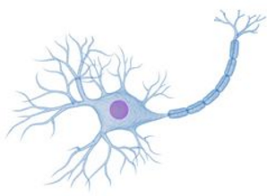
Neurons
Chapter 3 Human Perspectives: Neurons Communicate Quickly

Slide 3

Nervous System Overview
Example: A velociraptor escapes from Jurassic Park and enters the classroom:
Sensory NS: your eyes see the velociraptor and send a signal to the brain.
Central NS: your brain processes the information.
Consciously notices velociraptor, makes plan to run away, sends signal down spinal cord and out to leg muscles.
Conscious brain sends signal to hypothalamus to trigger “fight or flight” response.
Motor NS:
Carries conscious (somatic, voluntary) signal to skeletal system to move leg muscles to run away (or to use your friend as a shield)
Carries unconscious (autonomic, involuntary) signal to adrenal cortex to release adrenalin, which increases blood pressure, dilates respiratory passages … and so on.
Cells, tissues and organs need to work in an integrated, coordinated way to maintain homeostasis.
Nervous System (NS) allows this communication in a fast, responsive way.
Impulses passed along specialised cells called neurons.
Sensory NS – takes information from the body to the brain about:
External conditions: temperature, vision, hearing, touch, taste etc.
Internal conditions: blood pressure, blood gas and pH, stretch of intestines etc.
Central NS – brain and spinal cord
Spinal cord – takes information to and from brain, coordinates spinal reflexes
Brain – processes information and sends out response.
Motor NS - takes information from brain to body about response
Synapses are at muscles and glands
Stimulates movement, or glandular secretions
Has both voluntary and involuntary sections

Slide 4
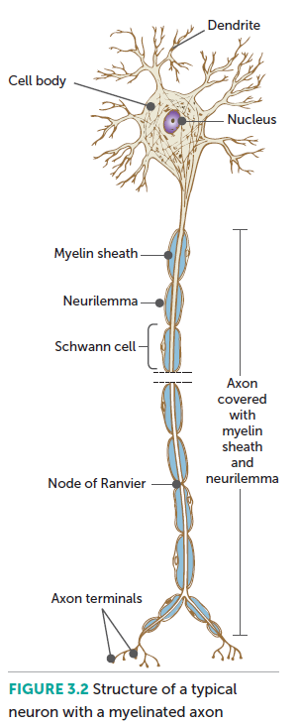
Nerve Cells (neurons)
Are the structural and functional unit of the nervous system
Vary in size and shape
COMMON FEATURES
Cell body:
Contains nucleus and organelles
Dendrites:
Short extensions of cell body
Highly branched
Receive stimulus and carry impulses to cell body
Axon (nerve fibre)
Longer extension
Carries nerve impulses away from cell body
Usually covered with myelin sheath (myelinated)
Unmyelinated = no myelin
Learning Aim: Describe the structure of a neuron, with location and function of common features

Slide 5
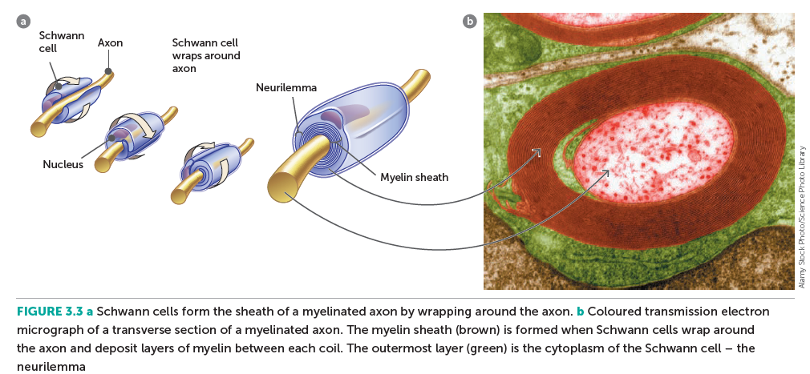
The Myelin Sheath and Neurilemma
Most neurons are myelinated – they have a myelin sheath:
Formed by specialised cells:
Schwann Cells – peripheral NS
Oligodendrocytes – central NS – myelin forms “white matter”.
Gaps along axon: nodes of Ranvier
3 functions of myelin sheath:
Acts as an insulator for impulses
Protects axon from external damage
Speeds movement of nerve impulses
Neurilemma: the outermost layer of Schwann cells – helps repair injured fibres by guiding regrowth.
Learning Aim: Describe the structure and functions of the myelin sheath

Slide 6
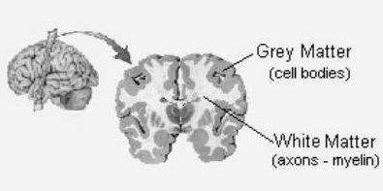
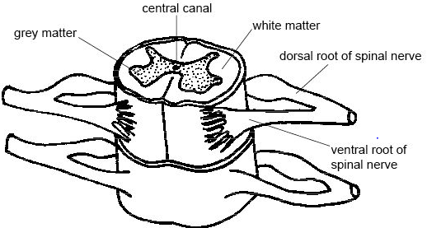
When CNS is cut open:
Grey matter:
Cell bodies
Unmyelinated fibres
White matter:
Myelinated fibres

Slide 7
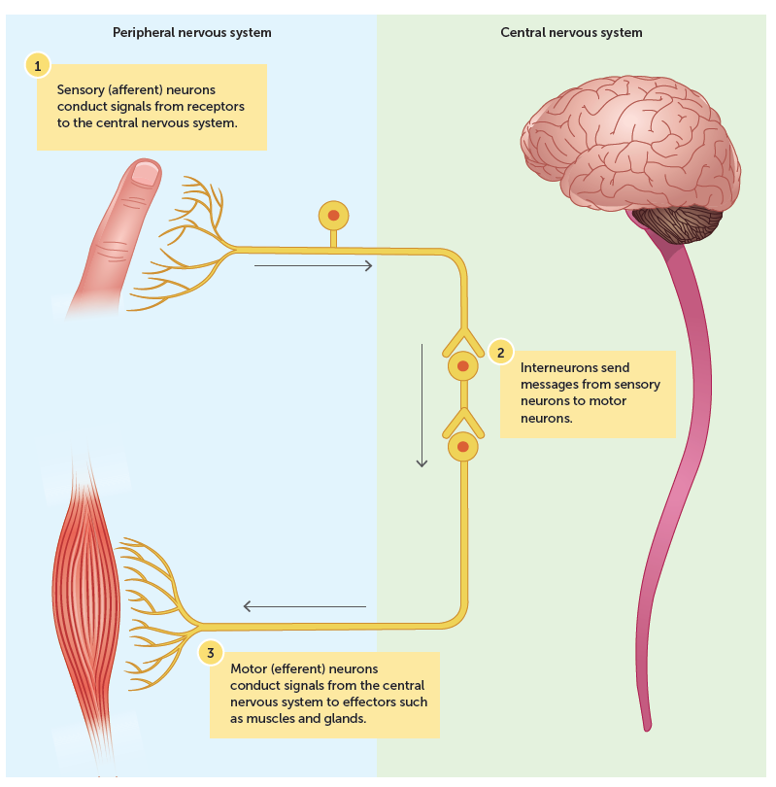
Types of neurons - Function
Neurons can be classified by function:
Sensory neurons
Also called afferent neurons, or receptor neurons
Carry messages from receptors to CNS
Interneurons
Also called association neurons, or relay neurons
Link between sensory and motor neurons
Generally in Central Nervous System (CNS)
Motor neurons
Also called effector neurons
Carry messages from CNS to muscles and glands
Can be somatic – under voluntary control, eg making skeletal muscle move
Can be autonomic – involuntary, eg controlling muscle lining blood vessels and glands
Learning Aim: Describe the three functional types of neuron

Slide 8
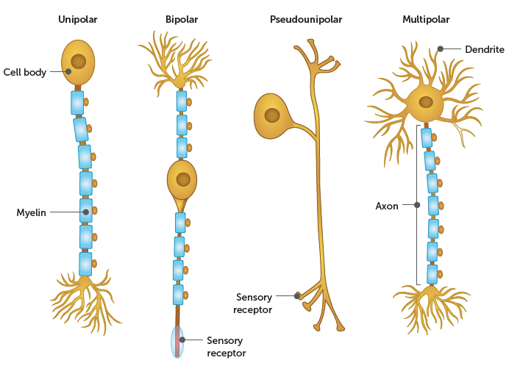
Types of neurons - Structure
Neurons can be classified by structure:
Multipolar
Most common
One axon, multiple dendrites
Axon may have multiple terminals
Interneurons and motor neurons are this type
Bipolar neurons
One axon, one dendrite, branching at ends
Generally part of special sense organs
Eg. in eye, ear, nose: take impulses from receptor to other neurons
Pseudounipolar neurons
Cell body to side
Most sensory neurons are this type
Sometimes (not really correctly) called unipolar
Unipolar neurons
No dendrites
Uncommon in vertebrates such as humans
Learning Aim: Describe the main structural types of neuron and describe where each occur

Slide 9
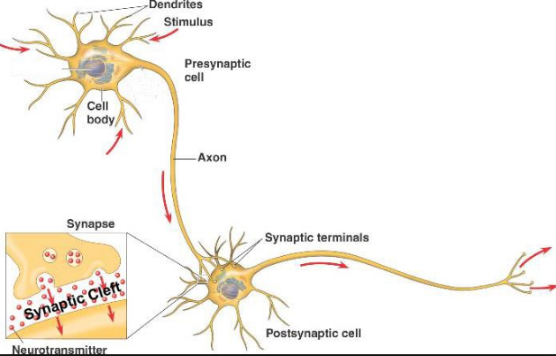
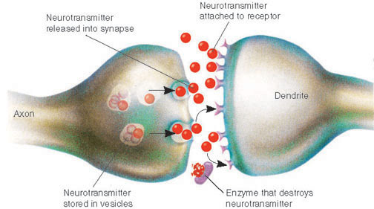
Synapses
Point where nerve impulses are passed from one neuron to another.
No join: small gap for chemical messages neurotransmitters to cross.
Also occur between nerve and muscle: neuromuscular junction
Learning Aim: Give an overview of the structure and function of the synapse

Slide 10
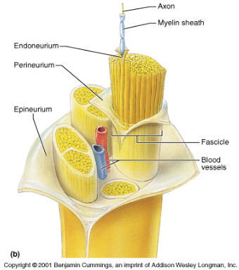
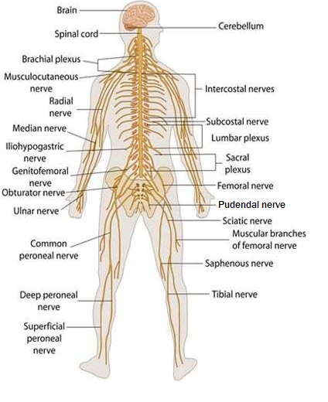
Nerves
Sensory and motor neurons are often bundled together into a single nerve that takes sensory information to the brain, and carries signals from the brain to move muscle/glands.
Are bundles of neurons (nerve fibres) extending out from the central nervous system.
Held together by connective tissue sheath
Three broad types:
SENSORY NERVES
Neurons are all sensory neurons
Take sensory information from the body to the CNS (Central Nervous System)
MOTOR NERVES
Neurons are all motor neurons
Take motor information (to tell body to move) from the CNS to the body
MIXED NERVES
Contain some bundles of sensory neurons and some bundles of motor neurons
Take information both to and from the CNS.
Learning Aim: Understand the structure of nerves and describe the three main types

Slide 11
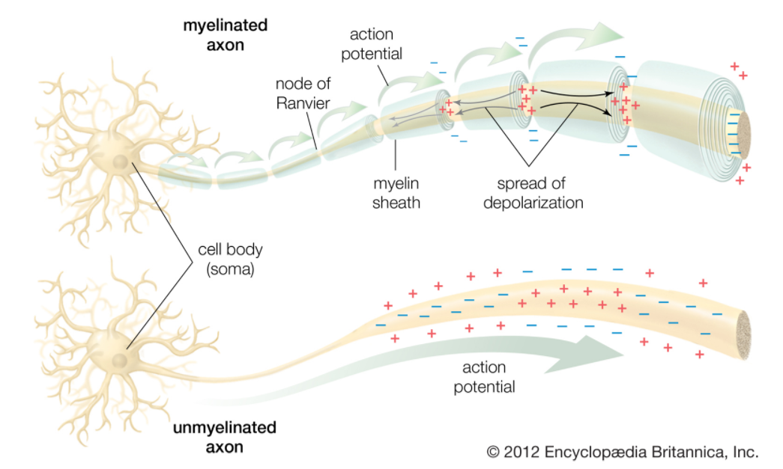
Transmission of Nerve Impulses (overview)
Impulses are transmitted along nerves using a wave of electro-chemical depolarisation called an action potential
1: Dendrites are stimulated, so they
trigger an action potential.
2: Action potential spreads down the
neuron:
dendrites → cell body → axon
3: Action potential reaches axon
terminal and triggers release of
neurotransmitters that cross the
synapse.
4: Neurotransmitters bind to the dendrites
on the other side of the synapse,
stimulating an action potential in the
next neuron.
Learning Aim: Give an overview of how nerve impulses are transmitted

